Slide 1

Smt. Kamala & Sri. Venkappa M. Agadi College Of Engineering & Technology Laxmeshwar-582116 2018-2019
Real-Time Monitoring of Bone Fracture Recovery by Using Aware, Sensing, Smart, and Active Orthopedic Devices
Under the guidance of
Prof.Nagaraj Telkar
Presented By
Pratibha H

Slide 2
contents

Slide 3
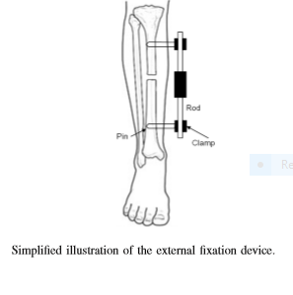
Introduction
This paper explores the use of IoT technologies in the ﬁeld of orthopedics
Motivation was related to resolving some issues of using external orthopedic ﬁxation devices for healing bone injuries and in leg extension treatment.

Slide 4
Introduction
Some external ﬁxation device are simple mechanical structures, consisting of a rod (often of variable length) with other attached components, which is mounted on the parts of the fractured bone, by using two or more pins (see Fig. 1).
Rod is aimed to hold parts of the fractured bone and, before formation of callus (ﬁrst formation of the new, soft bone tissue) at the fracture gap between bone fragments, the rod is receiving full load resulting from body weight.
In time, newly formed bone tissue will reach the mechanical properties of the healthy bone and it will be able to take over the load back from the ﬁxation device rod. At that time, the ﬁxation device is being removed from the patient

Slide 5
